Slide 1
Graph Algorithms-III
Minimum Spanning Tree-Kruskal, Prim’s Algorithm

Slide 2
Minimum Spanning Trees
Spanning Tree
A tree (i.e., connected, acyclic graph) which contains all the vertices of the graph
Minimum Spanning Tree
Spanning tree with the minimum sum of weights
Spanning forest
If a graph is not connected, then there is a spanning tree for each connected component of the graph
b
8
c
7
d
4
9
2
a
11
i
4
14
e
8
7
6
10
h
g
f
1
2

Slide 3
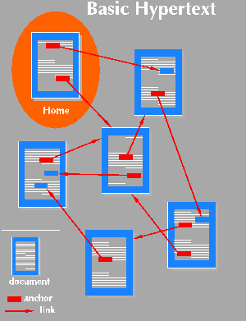
Applications of MST
Find the least expensive way to connect a set of cities, terminals, computers, etc.

Slide 4
Example
8
7
Problem
A town has a set of houses
and a set of roads
A road connects 2 and only
2 houses
A road connecting houses u and v has a repair
cost w(u, v)
Goal: Repair enough (and no more) roads such that:
Everyone stays connected
i.e., can reach every house from all other houses
2. Total repair cost is minimum
b
c
d
4
9
2
a
11
i
4
14
e
8
7
6
10
h
g
f
1
2

Slide 5
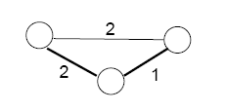
Properties of Minimum Spanning Trees
Minimum spanning tree is not unique
MST has no cycles – see why:
We can take out an edge of a cycle, and still have the vertices connected while reducing the cost
# of edges in a MST:
|V| - 1

Slide 6
Growing a MST – Generic Approach
Grow a set A of edges (initially empty)
Incrementally add edges to A such that they would belong
to a MST
An edge (u, v) is safe for A if and only if A ∪ {(u, v)} is also a subset of some MST
b
8
c
7
d
4
9
2
a
11
i
4
14
e
8
7
6
10
Idea: add only “safe” edges
h
g
f
1
2

Slide 7
Generic MST algorithm
A ← ∅
while A is not a spanning tree
do find an edge (u, v) that is safe for A
A ← A ∪ {(u, v)}
return A
How do we find safe edges?
b
8
c
7
d
4
9
2
a
11
i
4
14
e
8
7
6
10
h
g
f
1
2

Slide 8
Minimum Connector Algorithms
Kruskal’s algorithm
Select the shortest edge in a network
Select the next shortest edge which does not create a cycle
Repeat step 2 until all vertices have been connected
Prim’s algorithm
Select any vertex
Select the shortest edge connected to that vertex
Select the shortest edge connected to any vertex already connected
Repeat step 3 until all vertices have been connected

Slide 9
A cable company want to connect five villages to their network which currently extends to the market town of Avonford. What is the minimum length of cable needed?
Example
Brinleigh
5
Cornwell
3
4
8
6
8
Avonford
Fingley
Donster
7
5
4
2
Edan

Slide 10
We model the situation as a network, then the problem is to find the minimum connector for the network
B
5
C
3
4
8
6
8
A
F
D
7
5
4
2
E

Slide 11
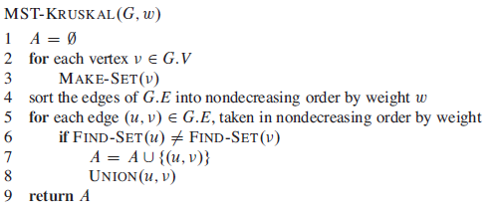
Kruskal Algorithm
Running time: O(V+ElgE+ElgV)=O(ElgE) or O(VlgE), if E<=V
O(V)
O(ElgE)
O(E)
O(lgV)

Slide 12
Kruskal’s Algorithm
List the edges in order of size:
ED 2
AB 3
AE 4
CD 4
BC 5
EF 5
CF 6
AF 7
BF 8
DF 8
B
5
C
3
4
8
6
8
A
D
7
F
5
4
2
E

Slide 13
Kruskal’s Algorithm
Select the shortest
edge in the network
ED 2
B
5
C
3
4
8
6
8
A
D
7
F
5
4
2
E

Slide 14
Kruskal’s Algorithm
B
5
Select the next shortest
edge which does not
create a cycle
ED 2
AB 3
C
3
4
8
6
8
A
D
7
F
5
4
2
E

Slide 15
Kruskal’s Algorithm
B
5
Select the next shortest
edge which does not
create a cycle
ED 2
AB 3
CD 4 (or AE 4)
C
3
4
8
6
8
A
D
7
F
5
4
2
E

Slide 16
Kruskal’s Algorithm
B
5
Select the next shortest
edge which does not
create a cycle
ED 2
AB 3
CD 4
AE 4
C
3
4
8
6
8
A
D
7
F
5
4
2
E

Slide 17
Kruskal’s Algorithm
B
5
Select the next shortest
edge which does not
create a cycle
ED 2
AB 3
CD 4
AE 4
BC 5 – forms a cycle
EF 5
C
3
4
8
6
8
A
D
7
F
5
4
2
E

Slide 18
Kruskal’s Algorithm
All vertices have been
connected.
The solution is
ED 2
AB 3
CD 4
AE 4
EF 5
Total weight of tree: 18
B
5
C
3
4
8
6
8
A
D
7
F
5
4
2
E

Slide 19
Find Spanning Tree using Kruskals Algorithm
8
7
b
c
d
4
9
2
a
11
i
14
e
4
7
6
8
10
h
g
f
1
2

Slide 20
Prim’s Algorithm
Select any vertex
A
Select the shortest edge connected to that vertex
AB 3
B
5
C
3
4
8
6
8
A
D
7
F
5
4
2
E

Slide 21
Prim’s Algorithm
Select the shortest
edge connected to
any vertex already
connected.
AE 4
B
5
C
3
4
8
6
8
A
D
7
F
5
4
2
E

Slide 22
Prim’s Algorithm
Select the shortest
edge connected to
any vertex already
connected.
ED 2
B
5
C
3
4
8
6
8
A
D
7
F
5
4
2
E

Slide 23
Prim’s Algorithm
B
5
Select the shortest
edge connected to
any vertex already
connected.
DC 4
C
3
4
8
6
8
A
D
7
F
5
4
2
E

Slide 24
Prim’s Algorithm
Select the shortest
edge connected to
any vertex already
connected.
EF 5
B
5
C
3
4
8
6
8
A
D
7
F
5
4
2
E

Slide 25
Prim’s Algorithm
B
5
All vertices have been
connected.
The solution is
AB 3
AE 4
ED 2
DC 4
EF 5
Total weight of tree: 18
C
3
4
8
6
8
A
D
7
F
5
4
2
E

Slide 26
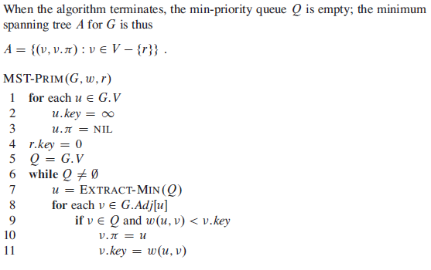
Prim’s Algorithm
Total time: O(VlgV + ElgV) = O(ElgV)
O(V) if Q is implemented as a min-heap
Min-heap operations:
O(VlgV)
Takes O(lgV)
Executed O(E) times total
Constant
O(ElgV)
Takes O(lgV)

Slide 27
Walk-Through
Initialize array
3
2
F
C
10
A
 | r | k_{v} | π_{v}
A | − | ∞ | −
B | − | ∞ | −
C | − | ∞ | −
D | − | ∞ | −
E | − | ∞ | −
F | − | ∞ | −
G | − | ∞ | −
H | − | ∞ | −
7
3
8
4
4
B
18
D
9
10
H
2
25
3
G
E
7

Slide 28
2
Start with any node, say D
F
3
C
10
A
 | r | k_{v} | π_{v}
A
B
C
D | T | 0 | −
E
F
G
H
7
3
8
4
4
B
18
D
9
10
H
2
25
3
G
E
7

Slide 29
2
Update distances of adjacent, unselected nodes
F
3
C
10
A
7
3
8
4
4
B
18
D
 | r | k_{v} | π_{v}
A
B
C |  | 3 | D
D | T | 0 | −
E |  | 25 | D
F |  | 18 | D
G |  | 2 | D
H
9
10
H
2
25
3
G
E
7

Slide 30
2
Select node with minimum distance
F
3
C
10
A
7
3
8
4
 | r | k_{v} | π_{v}
A
B
C |  | 3 | D
D | T | 0 | −
E |  | 25 | D
F |  | 18 | D
G | T | 2 | D
H
4
B
18
D
9
10
H
2
25
3
G
E
7

Slide 31
2
3
Update distances of adjacent, unselected nodes
F
C
10
A
7
3
8
4
18
 | r | k_{v} | π_{v}
A
B
C |  | 3 | D
D | T | 0 | −
E |  | 7 | G
F |  | 18 | D
G | T | 2 | D
H |  | 3 | G
4
B
D
9
10
H
2
25
3
G
E
7

Slide 32
2
Select node with minimum distance
F
3
C
10
A
7
3
8
4
 | r | k_{v} | π_{v}
A
B
C | T | 3 | D
D | T | 0 | −
E |  | 7 | G
F |  | 18 | D
G | T | 2 | D
H |  | 3 | G
4
B
18
D
9
10
H
2
25
3
G
E
7

Slide 33
2
3
Update distances of adjacent, unselected nodes
F
C
10
A
7
3
8
4
4
B
18
D
 | r | k_{v} | π_{v}
A
B |  | 4 | C
C | T | 3 | D
D | T | 0 | −
E |  | 7 | G
F |  | 3 | C
G | T | 2 | D
H |  | 3 | G
9
10
H
2
25
3
G
E
7

Slide 34
2
Select node with minimum distance
F
3
C
10
A
7
3
8
4
 | r | k_{v} | π_{v}
A
B |  | 4 | C
C | T | 3 | D
D | T | 0 | −
E |  | 7 | G
F | T | 3 | C
G | T | 2 | D
H |  | 3 | G
4
B
18
D
9
10
H
2
25
3
G
E
7

Slide 35
2
Update distances of adjacent, unselected nodes
F
3
C
10
A
7
3
8
4
 | r | k_{v} | π_{v}
A |  | 10 | F
B |  | 4 | C
C | T | 3 | D
D | T | 0 | −
E |  | 2 | F
F | T | 3 | C
G | T | 2 | D
H |  | 3 | G
4
B
18
D
9
10
H
2
25
3
G
E
7

Slide 36
2
Select node with minimum distance
F
3
C
10
A
7
3
8
4
 | r | k_{v} | π_{v}
A |  | 10 | F
B |  | 4 | C
C | T | 3 | D
D | T | 0 | −
E | T | 2 | F
F | T | 3 | C
G | T | 2 | D
H |  | 3 | G
4
B
18
D
9
10
H
2
25
3
G
E
7

Slide 37
2
3
Update distances of adjacent, unselected nodes
F
C
10
A
7
3
4
 | r | k_{v} | π_{v}
A |  | 10 | F
B |  | 4 | C
C | T | 3 | D
D | T | 0 | −
E | T | 2 | F
F | T | 3 | C
G | T | 2 | D
H |  | 3 | G
8
18
4
B
D
9
10
H
2
25
3
G
E
7
Table entries unchanged

Slide 38
2
3
Select node with minimum distance
F
C
10
A
7
3
8
4
 | r | k_{v} | π_{v}
A |  | 10 | F
B |  | 4 | C
C | T | 3 | D
D | T | 0 | −
E | T | 2 | F
F | T | 3 | C
G | T | 2 | D
H | T | 3 | G
4
B
18
D
9
10
H
2
25
3
G
E
7

Slide 39
2
Update distances of adjacent, unselected nodes
F
3
C
10
A
7
3
8
4
4
B
18
 | r | k_{v} | π_{v}
A |  | 4 | H
B |  | 4 | C
C | T | 3 | D
D | T | 0 | −
E | T | 2 | F
F | T | 3 | C
G | T | 2 | D
H | T | 3 | G
D
9
10
H
2
25
3
G
E
7

Slide 40
2
3
Select node with minimum distance
F
C
10
A
7
3
8
4
 | r | k_{v} | π_{v}
A | T | 4 | H
B |  | 4 | C
C | T | 3 | D
D | T | 0 | −
E | T | 2 | F
F | T | 3 | C
G | T | 2 | D
H | T | 3 | G
4
B
18
D
9
10
H
2
25
3
G
E
7

Slide 41
2
Update distances of adjacent, unselected nodes
F
3
C
10
A
7
3
4
 | r | k_{v} | π_{v}
A | T | 4 | H
B |  | 4 | C
C | T | 3 | D
D | T | 0 | −
E | T | 2 | F
F | T | 3 | C
G | T | 2 | D
H | T | 3 | G
8
18
4
B
D
9
10
H
2
25
3
G
E
7
Table entries unchanged

Slide 42
2
3
Select node with minimum distance
F
C
10
A
7
3
8
4
18
 | r | k_{v} | π_{v}
A | T | 4 | H
B | T | 4 | C
C | T | 3 | D
D | T | 0 | −
E | T | 2 | F
F | T | 3 | C
G | T | 2 | D
H | T | 3 | G
4
B
D
9
10
H
2
25
3
G
E
7

Slide 43
2
F
3
Cost of Minimum Spanning Tree = Σ d_{v} = 21
C
A
3
4
 | r | k_{v} | π_{v}
A | T | 4 | H
B | T | 4 | C
C | T | 3 | D
D | T | 0 | −
E | T | 2 | F
F | T | 3 | C
G | T | 2 | D
H | T | 3 | G
4
B
D
H
2
3
G
E

Slide 44
Find Spanning Tree using Prims Algorithm
8
7
b
c
d
4
9
2
a
11
i
14
e
4
7
6
8
10
h
g
f
1
2

Slide 45
Some points to note
Both algorithms will always give solutions with the same length.
They will usually select edges in a different order – you must show this in your workings.
Occasionally they will use different edges – this may happen when you have to choose between edges with the same length. In this case there is more than one minimum connector for the network.

